Slide 1
“Teach A Level Maths”
Statistics 1
Finding the Mean
© Christine Crisp

Slide 2
Statistics 1
AQA
EDEXCEL
MEI/OCR
OCR
"Certain images and/or photos on this presentation are the copyrighted property of JupiterImages and are being used with permission under license. These images and/or photos may not be copied or downloaded without permission from JupiterImages"

Slide 3
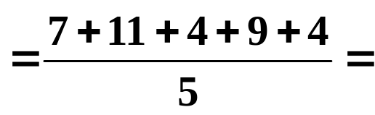

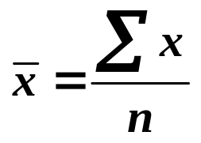

The arithmetic mean of a set of numbers is the average.
We refer to it simply as the mean.
e.g. Find the mean of the numbers 7, 11, 4, 9, 4
Solution:
mean
mean,
As a formula, we write:
is the Greek capital letter S and stands for Sum
It is read as “sigma”, so the formula is
“sigma x divided by n”
( The s um of the x values divided by the n umber of xs. )

Slide 4
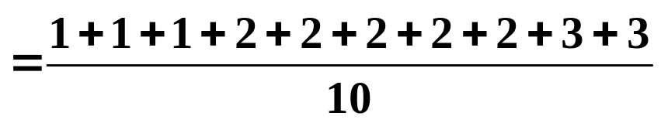
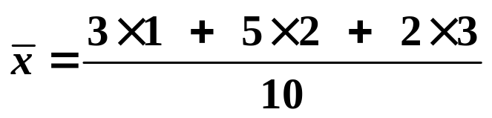
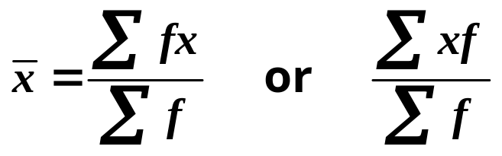
Adapting the Formula
e.g. Find the mean of the following data:
x | 1 | 2 | 3
Frequency, f | 3 | 5 | 2
We still need to add up the x values and divide by the number of xs. However, we have more than one of each x value.
The frequencies show we have 1, 1, 1, 2, 2, 2, 2, 2, 3, 3
so,
mean,
More simply,
This is written as

Slide 5
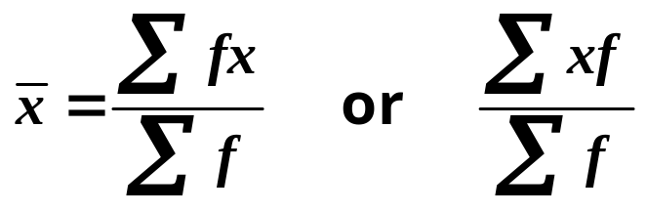
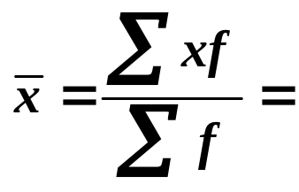
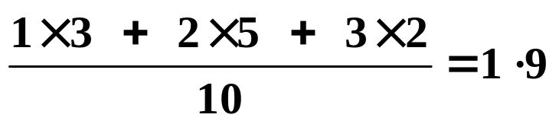
x | 1 | 2 | 3
Frequency, f | 3 | 5 | 2
mean,
Some of you have textbooks using the 1st of these ways of writing the formula and others the 2nd.
I’m going to use the 2nd for 2 reasons:
x comes first in the tables so xf is in a logical order,
this order should avoid a common error in another formula that we will meet soon.
So, mean,

Slide 6
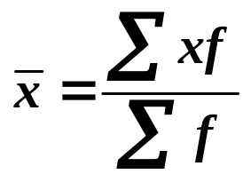

Using a Calculator
It’s really important to use your calculator efficiently, particularly in Statistics.
Suppose we have the following data:
x | 12 | 16 | 18 | 22 | 27
f | 5 | 8 | 9 | 6 | 2
mean,
Instead of using the calculator to multiply each x by f, we enter the data as lists or cards ( depending on which calculator we have ). You will need the Statistics option.
Try this now with the above data.

Slide 7


Using a Calculator
It’s really important to use your calculator efficiently, particularly in Statistics.
Suppose we have the following data:
x | 12 | 16 | 18 | 22 | 27
f | 5 | 8 | 9 | 6 | 2
mean,
Now go back through the data to check that you have entered the correct numbers before continuing.
This is tedious but essential ( every time )!
Next select the menu that shows the results and you will find and other results we will use later.
We get
( We usually give answers to 3 s.f. )

Slide 8
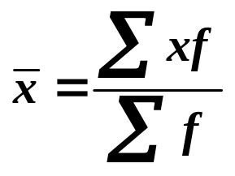
Mean of Grouped Data
e.g. The data gives travel times to school for a sample of Canadian children. Find the mean travelling time.
Time (mins)
1-10
11-20
21-30
31-40
41-50
51-60
61 −
No. of children
3531
2129
994
292
433
193
111
Source: CensusAtSchool, Canada 2003/4
where x is the time (mins) and f is the number of children ( the frequency ).
mean,
For grouped data, the group mid-values are used for x.

Slide 9
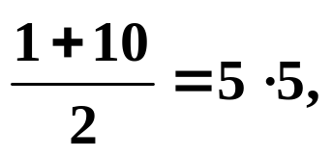
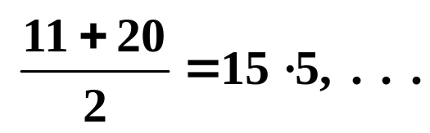
Mean of Grouped Data
e.g. The data gives travel times to school for a sample of Canadian children. Find the mean travelling time.
Time (mins) | 1-10 | 11-20 | 21-30 | 31-40 | 41-50 | 51-60 | 61 −
x
No. of children | 3531 | 2129 | 994 | 292 | 433 | 193 | 111
5 ·5
15 ·5
25 ·5
35 ·5
45 ·5
55 ·5
where x is the time (mins) and f is the number of children ( the frequency ).
mean,
For grouped data, the group mid-values are used for x.
To find these just average the upper and lower values given for each group.
e.g.

Slide 10
Mean of Grouped Data
e.g. The data gives travel times to school for a sample of Canadian children. Find the mean travelling time.
Time (mins) | 1-10 | 11-20 | 21-30 | 31-40 | 41-50 | 51-60 | 61 −
x
No. of children | 3531 | 2129 | 994 | 292 | 433 | 193 | 111
5 ·5
15 ·5
25 ·5
35 ·5
45 ·5
55 ·5
70 ·5
where x is the time (mins) and f is the number of children ( the frequency ).
mean,
As we are not given the longest time we must make a sensible assumption. I’ve chosen 80 mins. ( giving 70·5 for the mid-value ).

Slide 11


Mean of Grouped Data
e.g. The data gives travel times to school for a sample of Canadian children. Find the mean travelling time.
Time (mins) | 1-10 | 11-20 | 21-30 | 31-40 | 41-50 | 51-60 | 61 −
x
No. of children | 3531 | 2129 | 994 | 292 | 433 | 193 | 111
5 ·5
15 ·5
25 ·5
35 ·5
45 ·5
55 ·5
70 ·5
where x is the time (mins) and f is the number of children ( the frequency ).
mean,
We can now enter the data into our calculators and find the mean.
mean,

Slide 12
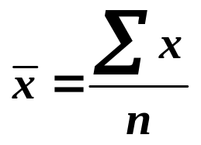

SUMMARY
Finding the Mean:
For simple data
For frequency data
For grouped data use the frequency data formula, taking each x to be the mid-point of the group.
( Remember that for ages, the group boundaries are not the same as with other data. )
Calculator use: Enter x and f values and use statistical functions to find the answer.
Unless told otherwise, answers are given to 3 s.f.

Slide 13

Exercise
Find the mean of each data set shown:
1.
5, 11, 14, 7, 13
2.
x | 1 | 2 | 3 | 4 | 5 | 6
f | 1 | 8 | 13 | 17 | 10 | 11
3.
Length (cm) | 1-10 | 11-20 | 21-30 | 31-40
f | 4 | 7 | 13 | 17
4.
Age (years) | 0-9 | 10-19 | 20-59 | 60-99
f | 11 | 25 | 16 | 9

Slide 14
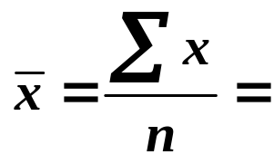

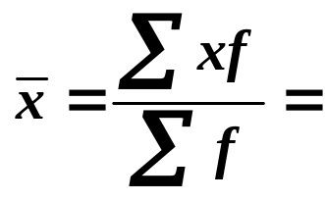

Solutions:
1.
5, 11, 14, 7, 13
Solution:
2.
x
1
2
3
4
5
6
f
1
8
13
17
10
11
Solution:

Slide 15

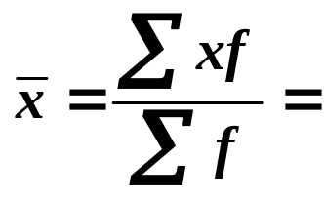


3.
Length (cm)
1-10
11-20
21-30
31-40
x
5·5
15·5
25·5
35·5
f
4
7
13
17
Solution:
4.
Age (years)
0-9
10-19
20-59
60-99
x
5
15
40
80
f
11
25
16
9
N.B. Age data so the u.c.bs. are 10, 20, . . . making the mid-points 5, 15, . . .

Slide 16


Slide 17
The following slides contain repeats of information on earlier slides, shown without colour, so that they can be printed and photocopied.
For most purposes the slides can be printed as “Handouts” with up to 6 slides per sheet.

Slide 18
SUMMARY
Finding the Mean:
For simple data
For frequency data
For grouped data use the frequency data formula, taking each x to be the mid-point of the group.
( Remember that for ages, the group boundaries are not the same as with other data. )
Calculator use: Enter x and f values and use statistical functions to find the answer.
Unless told otherwise, answers are given to 3 s.f.

Slide 19
Mean of Grouped Data
e.g. The data gives travel times to school for a sample of Canadian children. Find the mean travelling time.
Time (mins)
1-10
11-20
21-30
31-40
41-50
51-60
>60
No. of children
3531
2129
994
292
433
193
111
Source: CensusAtSchool, Canada 2003/4
where x is the time (mins) and f is the number of children ( the frequency ).
mean,
For grouped data, the group mid-values are used for x.

Slide 20

To find mid-values just average the upper and lower values given for each group.
e.g.
Time (mins)
1-10
11-20
21-30
31-40
41-50
51-60
>60
x
5 ·5
15 ·5
25 ·5
35 ·5
45 ·5
55 ·5
70 ·5
No. of children
3531
2129
994
292
433
193
111
As we are not given the longest time we must make a sensible assumption. I’ve chosen 80 mins. ( giving 70·5 for the mid-value ).
mean,

